Slide 1
Righteousness of God
Now we do speak wisdom among the mature, but not a wisdom of this age or of the rulers of this age, who are perishing. (7) Instead, we speak the wisdom of God, hidden in a mystery, that God determined before the ages for our glory. (8) None of the rulers of this age understood it. If they had known it, they would not have crucified the Lord of glory. (9) But just as it is written, “Things that no eye has seen, or ear heard, or mind imagined, are the things God has prepared for those who love him.” (10) God has revealed these to us by the Spirit. For the Spirit searches all things, even the deep things of God. (11) For who among men knows the things of a man except the man’s spirit within him? So too, no one knows the things of God except the Spirit of God. (12) Now we have not received the spirit of the world, but the Spirit who is from God, so that we may know the things that are freely given to us by God. (13) And we speak about these things, not with words taught us by human wisdom, but with those taught by the Spirit, explaining spiritual things to spiritual people. (14) The unbeliever does not receive the things of the Spirit of God, for they are foolishness to him. And he cannot understand them, because they are spiritually discerned. (15) The one who is spiritual discerns all things, yet he himself is understood by no one. (16) For who has known the mind of the Lord, so as to advise him? But we have the mind of Christ.
1 Corinthians 2:6-16
https://tinyurl.com/RightWithGod

Slide 2
Quick Review Foundations of Man’s Righteousness
From the beginning, sin introduced uncertainty into the human experience. When humanity lost trust in God, fear took its place. Fear, in turn, demands control, and control leads people to build systems. Genesis 3 captures this shift when Adam says, “I was afraid… so I hid.” Fear pushes people to ask: Am I safe? Am I accepted? Am I right? Instead of resting in God’s righteousness, humans attempt to manufacture their own.
This pattern repeats throughout history. Uncertainty leads to systems, systems shape culture, culture defines a “path to the good life,” and those systems are enforced against anyone who questions them. The Pharisees are a clear example. After centuries without prophetic guidance, they believed that perfect obedience to all 613 laws would force God’s hand and restore Israel. Their theological systems became cultural identity, enforced as righteousness.
Because religious leaders like the Levites were socially insulated and did not experience the consequences of their teachings, they could impose heavy burdens on others without feeling their weight. Jesus directly confronted this hypocrisy, noting how leaders placed crushing demands on people while refusing to help carry them.

Slide 3
Quick Review Foundations of Man’s Righteousness
The same pattern can appear in the Church today. Communities may silence truth-tellers because they create discomfort. Over time, this leads to a culture disconnected from reality. When leaders confuse God’s Word with their interpretations of it, human reasoning becomes codified as divine truth. This creates harm, benefits some, and elevates man-made systems to a place only God should hold.
The solution is not more certainty through systems, but deeper security in Christ. We must prioritize relationship over control, humility over certainty, and Christ Himself as Truth. Systems feel safe and logical, but relationships are messy and uncertain. Yet they are where spiritual life, meaning, and God’s blessing are found.

Slide 4
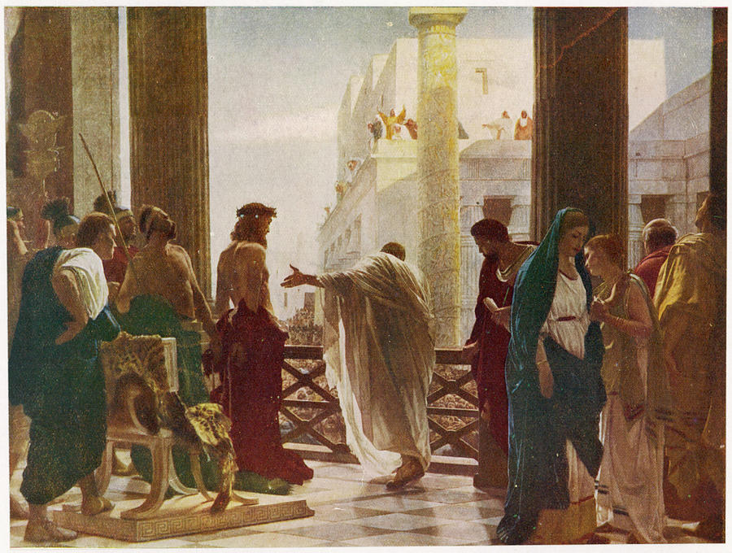
For this reason… John 18:37
Jesus replied, “… For this reason I was born, and for this reason I came into the world – to testify to the truth. Everyone who belongs to the truth listens to my voice.
Notes:
John 18:33-37
(33) So Pilate went back into the governor’s residence, summoned Jesus, and asked him, “Are you the king of the Jews?”
(34) Jesus replied, “Are you saying this on your own initiative, or have others told you about me?”
(35) Pilate answered, “I am not a Jew, am I? Your own people and your chief priests handed you over to me. What have you done?”
(36) Jesus replied, “My kingdom is not from this world. If my kingdom were from this world, my servants would be fighting to keep me from being handed over to the Jewish authorities. But as it is, my kingdom is not from here.”
(37) Then Pilate said, “So you are a king!” Jesus replied, “You say that I am a king. For this reason I was born, and for this reason I came into the world – to testify to the truth. Everyone who belongs to the truth listens to my voice.”
Joh 14:6
(6) Jesus replied, “I am the way, and the truth, and the life. No one comes to the Father except through me.
Joh 14:23
(23) Jesus replied, “If anyone loves me, he will obey my word, and my Father will love him, and we will come to him and take up residence with him.
I Cor. 2:13-16
“…but we have the mind of Christ”

Slide 5
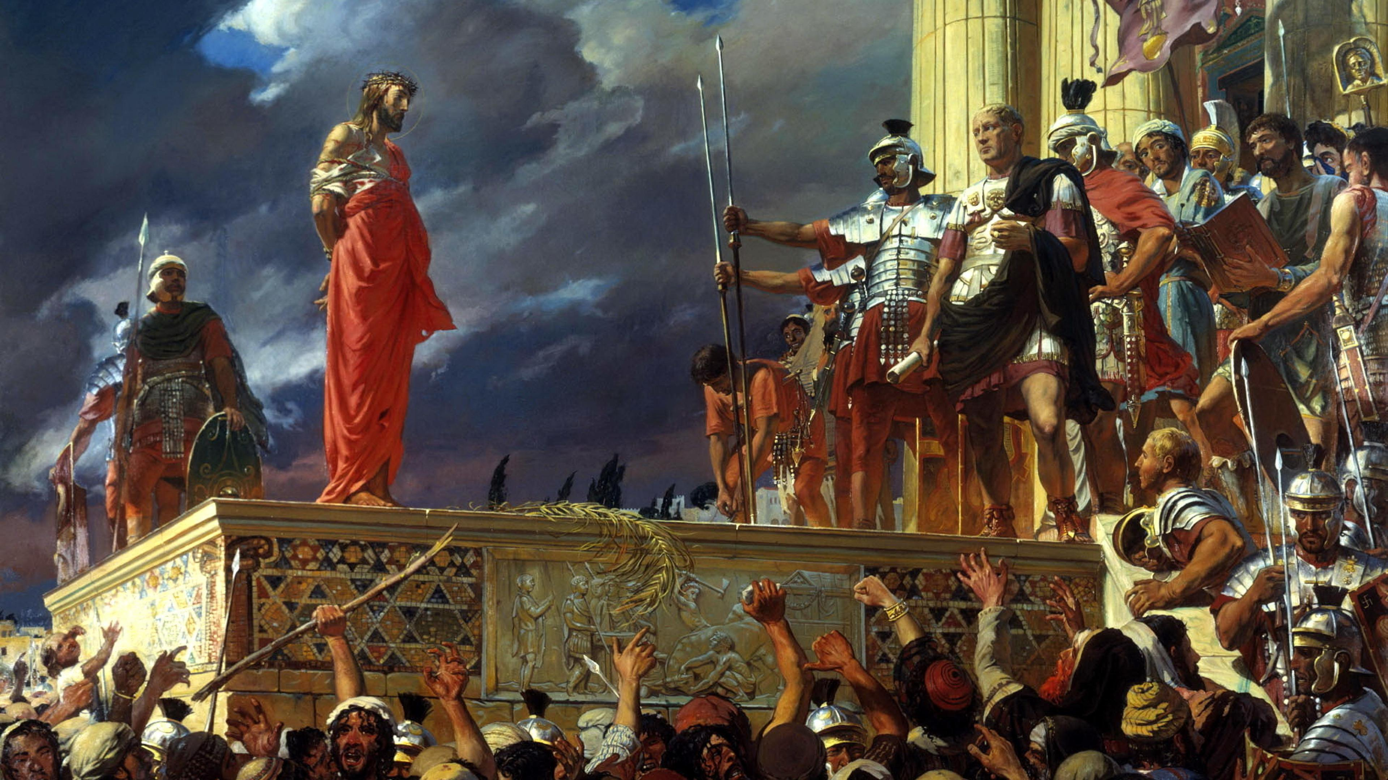
Behold the Man!
John 19:5
“None of the rulers of this age understood it. If they had known it, they would not have crucified the Lord of glory.” Paul the Apostle, 1 Corinthians 2:8
Notes:
Ecce Homo (“Behold the Man”) by Antonio Ciseri, 1871
The title comes from John 19:5: “So Jesus came out, wearing the crown of thorns and the purple robe. Pilate said to them, ‘Look, here is the man!’”
John 19:4–6 : “Then Pilate went outside again and said to them, ‘Look, I am bringing him out to you, so that you may know that I find no reason for an accusation against him.’ So Jesus came out… When the chief priests and their officers saw him, they shouted out, ‘Crucify! Crucify!’”
This reflects Isaiah 53:7: “He was oppressed and afflicted, yet he did not open his mouth.”
Connection to this Study Theme
This image visually captures:
the righteousness of God standing silent
the righteousness of man expressed through law, crowd pressure, and political calculation
Pilate represents system-driven order.
The crowd represents fear-driven morality.
Jesus represents God’s righteousness without control.
John 18:36 : “My kingdom is not from this world.”
That contrast is the heart of the painting.

Slide 6
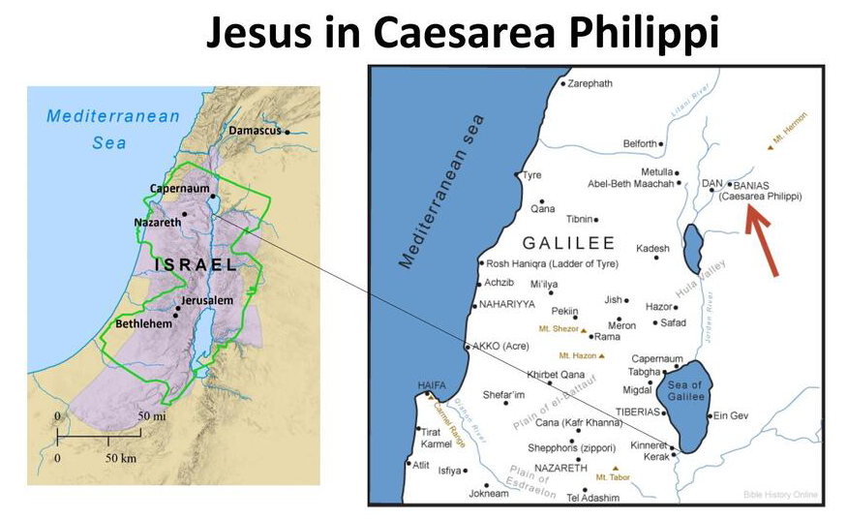
“Upon this rock” : Mark 8:27-38; Matthew 16:13-28; Luke 9:18-27
“Upon the high mountain” : Mark 9:2-12; Matthew 17:1-13; Luke 9:28-36

Slide 7
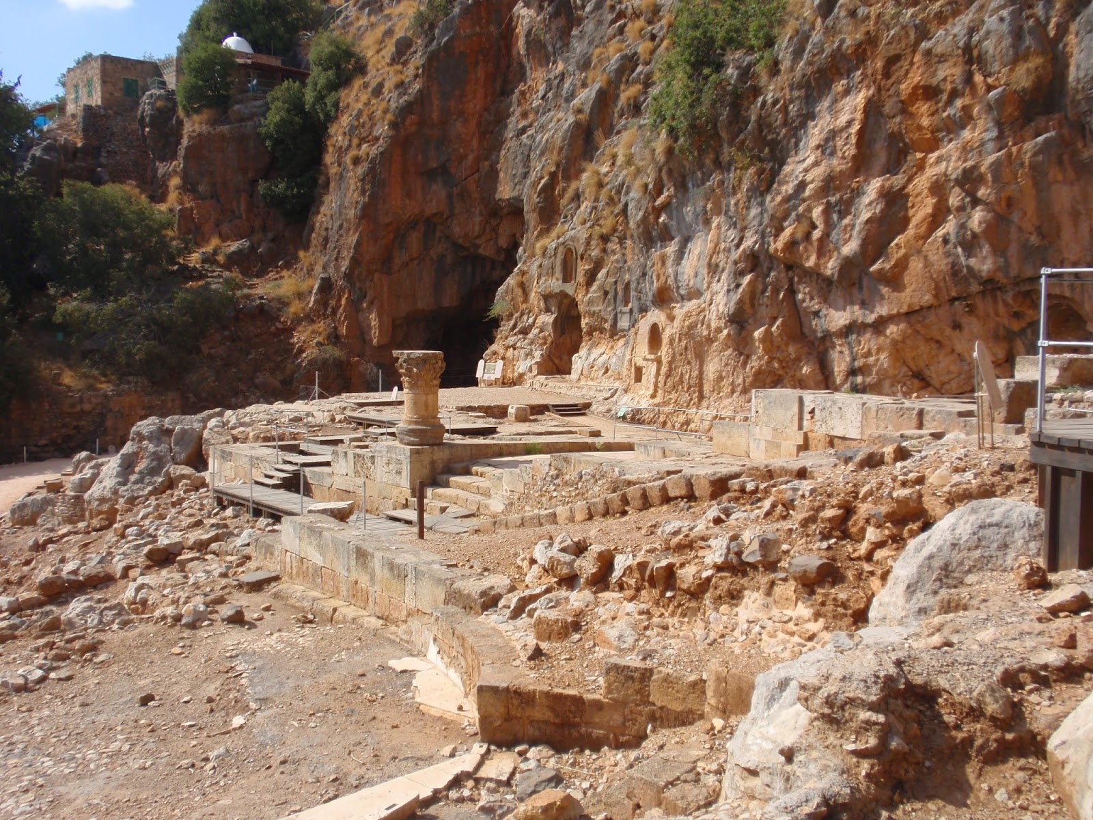
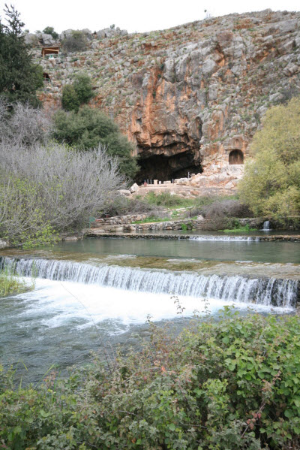
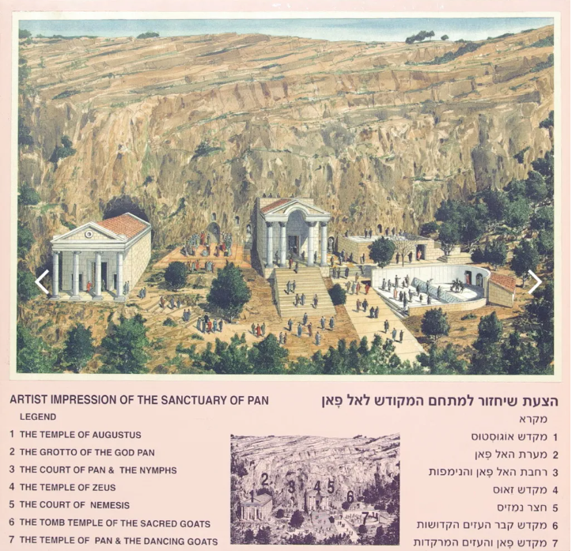
Coming Soon… Lesson 7 How the Early Church Resisted System-Driven Religion

Slide 8
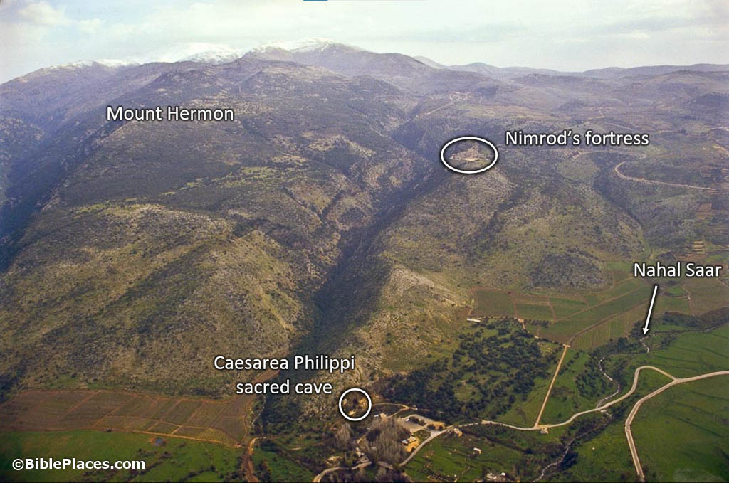
“Upon this rock” : Mark 8:27-38; Matthew 16:13-28; Luke 9:18-27
“Upon the high mountain” : Mark 9:2-12; Matthew 17:1-13; Luke 9:28-36

Slide 9
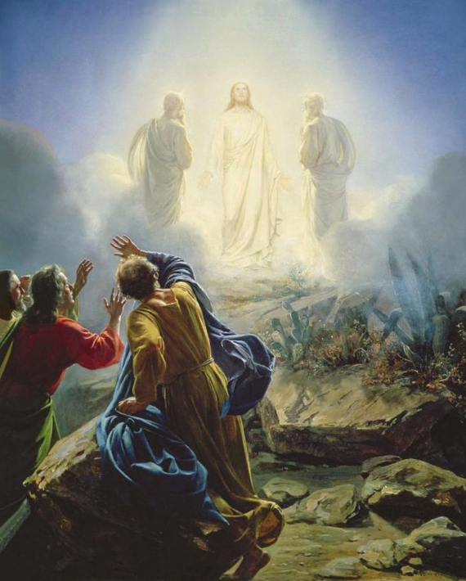
Mount Hermon is:
The highest mountain in the region
In Second Temple thought:
High places = authority
Mountains = divine or cosmic meeting points
Mt Hermon becomes:
The origin site of angelic rebellion
The place where heaven–earth boundaries were violated
In 1 Enoch, Mount Hermon is the place where angels broke covenant with God, corrupted humanity, and triggered a chain of judgment that explains the origin of demons, making the Hermon region a symbolic ground zero for cosmic rebellion in Second Temple Jewish thought.
Notes:
Luke 24 – Emmaus Road – Jesus had to “open their minds” to understanding.
See the document: Synopsis of the 1st Enoch Narrative

Slide 10
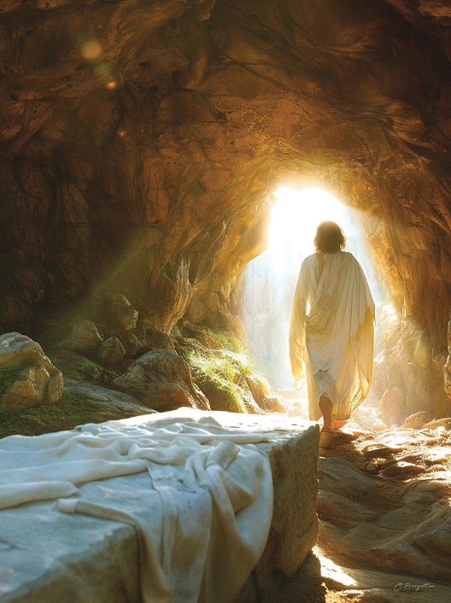
He has destroyed what was against us, a certificate of indebtedness expressed in decrees opposed to us. He has taken it away by nailing it to the cross. Disarming the rulers and authorities, he has made a public disgrace of them, triumphing over them by the cross. (Col 2:14-15)
Therefore, since the children share in flesh and blood, he likewise shared in their humanity, so that through death He could destroy the one who holds the power of death (that is, the devil) and set free those who were held in slavery all their lives by their fear of death. For surely his concern is not for angels, but He is concerned for Abraham’s descendants. (Heb 2:14-16)
Notes:
Reclaim the Sacred Space
Matt 28:16-20 So the eleven disciples went to Galilee to the mountain Jesus had designated. (17) When they saw him, they worshiped him, but some doubted. (18) Then Jesus came up and said to them, “All authority in heaven and on earth has been given to me. (19) Therefore go and make disciples of all nations, baptizing them in the name of the Father and the Son and the Holy Spirit, (20) teaching them to obey everything I have commanded you. And remember, I am with you always, to the end of the age.”
The Temple is now represented by each Human Being. The sacred space. Take the Kingdom back one temple at a time.

Slide 11
Righteousness Starts With God, Not Man Who is the standard?
Romans 10:3 They sought to establish their own righteousness and did not submit to God’s righteousness.
Psalm 119:142 Your righteousness is an everlasting righteousness
Deuteronomy 32:4 He is the Rock, His work is perfect; For all His ways are justice, A God of truth and without injustice; Righteous and upright is He.
In the Bible, righteousness does not begin with human behavior.
It begins with who God is.
God does not measure Himself by a standard outside of Himself.
He is the standard.
God is righteous because His nature is righteous.
He does what is right because He is right.
Human ideas of goodness change.
God does not change.
Notes:
Righteousness Starts With God, Not Man
Regardless of God’s display of righteousness, mankind, throughout history has sought to establish himself as the measure of all things. Why?
Human Righteousness Tries to Earn God’s Favor
Paul warns against trying to create one’s own righteousness.
“They sought to establish their own righteousness, and did not submit to God’s righteousness.” (Rom 10:3 NET)
This is the heart of the difference.
Human righteousness says:
“I can make myself right.”
God’s righteousness says:
“You cannot make yourself right, but I will make you right through Christ.”

Slide 12
Coming Soon… Lesson 7 How Grace Dismantles Fear-Based Systems in the New Testament
Apostolic Pattern: From System to Life
Every New Testament covenantal concept shift follows this pattern:
from law to Life
from fear to Faith
from performance to Promise
from system to Spirit
2 Corinthians 3:17 “Now the Lord is the Spirit, and where the Spirit of the Lord is present, there is freedom.”
Romans 8:15 “For you did not receive the spirit of slavery leading again to fear, but you received the Spirit of adoption.”
Lesson Abstract
Fear builds systems to protect cultural identity.
Grace reveals identity so systems are no longer needed.
Fear asks: Am I safe?
Grace answers: You are mine.
And once that is settled,
righteousness no longer needs to be managed.
Notes:
How Grace Dismantles Fear-Based Systems in the New Testament
1. Fear Builds Systems. Grace Exposes Them.
Fear always asks:
How do I protect myself?
How do I stay accepted?
Grace asks something else:
Who is God, and can He be trusted?
Romans 8:15
“For you did not receive the spirit of slavery leading again to fear, but you received the Spirit of adoption.”
Fear produces slavery.
Grace produces sonship.
Systems need fear to survive.
Grace removes the fear that systems depend on.
2. Grace Removes the Need for Control
Fear-based systems work by control:
rules
penalties
social pressure
Grace replaces control with relationship.
Galatians 4:4–7
“So you are no longer a slave but a son, and if you are a son, then you are also an heir through God.”
A slave needs rules to survive.
A son lives from belonging.
Once belonging is secure, control loses its power.
3. Grace Shifts Obedience From Fear to Love
Fear-based obedience asks:
What happens if I fail?
Grace-based obedience asks:
How do I honor the one who loves me?
1 John 4:18
“There is no fear in love, but perfect love drives out fear.”
Fear cannot coexist with love.
When love rules, systems collapse.
4. Grace Dismantles Religious Hierarchies
Fear-based systems require mediators:
experts
gatekeepers
elites
Grace gives direct access to God.
Hebrews 4:16
“Therefore let us confidently approach the throne of grace to receive mercy and find grace whenever we need help.”
Confidence replaces dependence on religious authority structures.
This is why grace always threatens institutional control.
5. Grace Ends the Need for Performance Identity
Fear-based systems define worth by performance.
Grace defines identity by Christ.
Ephesians 2:8–9
“For by grace you are saved through faith… it is the gift of God; it is not from works.”
If righteousness is a gift,
there is nothing left to earn.
Systems collapse when comparison loses meaning.
6. Grace Replaces External Rules With Internal Transformation
Fear systems manage behavior.
Grace changes the heart.
Titus 2:11–12
“For the grace of God has appeared… training us to reject godless ways.”
Grace teaches.
Law demands.
Fear controls from the outside.
Grace forms from the inside.
7. Grace Breaks Social Contracts Inside the Church
Social contracts say:
behave and belong
conform and be accepted
Grace says:
belong, therefore grow
Romans 15:7
“Receive one another, just as Christ also received you.”
Christ did not receive us after improvement.
He received us before it.
This destroys transactional righteousness.
8. Grace Destroys the Economy of Shame
Fear-based systems need shame to function.
Grace absorbs shame.
Hebrews 12:2
“He endured the cross, disregarding its shame.”
When shame is removed,
fear loses its leverage.
9. Grace Makes the Law Obsolete as a Control System
The Law exposed sin.
Grace removes condemnation.
Romans 8:1
“There is therefore now no condemnation for those who are in Christ Jesus.”
Without condemnation:
fear loses urgency
systems lose authority
trust becomes possible
10. Why Grace Is So Threatening
Grace cannot be controlled.
It cannot be measured.
It cannot be monopolized.
Galatians 5:1
“For freedom Christ has set us free.”
Freedom is dangerous to systems.
But it is essential for life.
11. Apostolic Pattern: From System to Life
Every New Testament shift follows this pattern:
from law to life
from fear to faith
from performance to promise
from system to Spirit
2 Corinthians 3:17 “Now the Lord is the Spirit, and where the Spirit of the Lord is present, there is freedom.”
Final Summary
Fear builds systems to protect identity.
Grace reveals identity so systems are no longer needed.
Fear asks: Am I safe?
Grace answers: You are mine.
And once that is settled,
righteousness no longer needs to be managed.

Slide 13
Coming Soon… Lesson 9 How the Early Church Resisted System-Driven Religion
Notes:
How the Early Church Resisted System-Driven Religion
1. They Resisted Replacing Christ With a System
The apostles did not offer a new religious structure.
They proclaimed a risen Lord.
Acts 2:36
“God has made this Jesus whom you crucified both Lord and Christ.”
Their allegiance was personal, not institutional.
Christ was not the foundation of a system.
He was the center of life.
This is why the church spread before it had buildings, creeds, or hierarchies.
2. They Rejected Law as a Control Mechanism
The first major crisis tested this directly.
Should Gentile believers submit to the Jewish Law?
The apostles answered clearly.
Acts 15:10–11
“Why are you putting God to the test by placing on the neck of the disciples a yoke that neither our ancestors nor we have been able to bear?”
They refused to rebuild the Law as a righteousness system.
This moment defined the church:
no ethnic righteousness
no performance entry
no system replacing grace
3. They Centered Fellowship, Not Regulation
Early Christian life was relational, not procedural.
Acts 2:42
“They were devoting themselves to the apostles’ teaching and to fellowship, to the breaking of bread and to prayer.”
Notice what is missing:
no rulebook
no enforcement structure
no membership system
Order existed.
Control did not.
4. They Lived Without Temple Dependence
The early church did not build a replacement temple.
They believed something radical.
1 Corinthians 3:16
“Do you not know that you are God’s temple and that God’s Spirit lives in you?”
This removed sacred space as a control tool.
No priesthood monopoly.
No sacred geography.
No system of access.
5. They Resisted Religious Elites
Authority existed, but it was relational and accountable.
Matthew 23:8
“But you are not to be called ‘Rabbi,’ for you have one Teacher and you are all brothers.”
Early leaders served.
They did not dominate.
1 Peter 5:2–3
“Shepherd the flock of God among you… not as lording it over those entrusted to you.”
System-driven religion needs rank.
The early church emphasized brotherhood.
6. They Refused Social Contract Morality
The church did not blend into Roman civic religion.
Their righteousness did not come from social approval.
Acts 5:29
“We must obey God rather than people.”
They were willing to suffer exclusion rather than compromise allegiance.
This is why persecution followed.
Grace-made people do not submit easily to moral systems.
7. They Practiced Voluntary, Not Enforced, Obedience
Giving, service, and sacrifice were not compelled.
2 Corinthians 9:7
“Each one of you should give just as he has decided in his heart… for God loves a cheerful giver.”
Fear systems demand compliance.
Grace invites response.
This preserved sincerity and humility.
8. They Kept Repentance Central
System religion minimizes repentance.
It prefers rule-keeping.
The early church preached repentance constantly.
Acts 3:19
“Therefore repent and turn back so that your sins may be wiped out.”
Repentance keeps power from settling into systems.
It keeps everyone equal at the foot of the cross.
9. They Expected the Spirit to Lead
The early church trusted the Spirit more than structure.
Romans 8:14
“For all who are led by the Spirit of God are the sons of God.”
This did not mean chaos.
It meant dependence.
Systems promise predictability.
The Spirit requires trust.
10. They Warned Against Returning to Systems
The apostles repeatedly warned believers not to go backward.
Galatians 5:4
“You have been severed from Christ, you who are trying to be justified by the law.”
Returning to system-based righteousness was seen as spiritual danger.
Not maturity.
Not stability.
11. Why This Resistance Could Not Last Forever
By the late second and third centuries:
persecution increased
growth demanded organization
fear re-entered
Systems slowly replaced trust.
But the New Testament witness remains clear:
life before institution
grace before structure
covenant before contract
Summary
The early church resisted system-driven religion by:
centering on Christ, not control
trusting grace over law
valuing relationship over regulation
obeying from love, not fear
living by covenant, not contract
They were not anti-order.
They were anti-replacement.
Anything that replaces trust in God’s righteousness becomes the righteousness of man.

Slide 14
Coming Soon… Lesson 11 How the New Testament Balances Order Without Control
Notes:
How the New Testament Balances Order Without Control
1. Order Comes From Life, Not Enforcement
In the New Testament, order grows out of shared life in Christ.
It is not imposed from above.
1 Corinthians 14:33
“For God is not a God of disorder but of peace.”
Peace flows from God’s presence, not from strict regulation.
Order is the fruit of the Spirit working in people, not the result of tight systems.
2. Authority Is Functional, Not Positional
Authority exists, but it serves the body.
It is not a chain of command.
Ephesians 4:11–12
“It was he who gave some as apostles, some as prophets, some as evangelists, and some as pastors and teachers, to equip the saints.”
Leaders equip.
They do not control.
Their role is temporary and purpose-driven.
3. Leadership Is Plural, Not Centralized
The New Testament avoids single-point control.
Acts 14:23
“They appointed elders for them in the various churches.”
Plural elders prevent domination.
Shared leadership limits abuse.
This keeps authority relational and accountable.
4. Submission Is Mutual, Not Coerced
Submission is voluntary and reciprocal.
Ephesians 5:21
“Submitting to one another out of reverence for Christ.”
This removes hierarchy as a control tool.
Submission flows from shared reverence, not fear.
5. Teaching Guides Conscience, Not Compliance
Teaching shapes understanding.
It does not replace conscience.
Romans 14:5
“Each person must be fully convinced in his own mind.”
The apostles respected personal conviction in non-essential matters.
Systems demand uniformity.
The New Testament allows space for growth.
6. Correction Restores, Not Punishes
Discipline exists, but its goal is restoration.
Galatians 6:1
“Restore such a person in a spirit of gentleness.”
Gentleness protects dignity.
Fear-based systems use discipline to maintain power.
Grace-based order uses it to heal.
7. Freedom Is Protected, Not Feared
Freedom is not chaos.
It is responsibility before God.
Galatians 5:13
“You were called to freedom… only do not use your freedom as an opportunity for the flesh.”
The solution to misuse is love, not control.
8. Unity Is Rooted in Christ, Not Rules
Unity comes from shared life in Christ.
Philippians 2:1–2
“If there is any encouragement in Christ… be of the same mind.”
Unity is cultivated, not enforced.
Rules can create compliance.
They cannot create love.
9. Decisions Are Discerned, Not Dictated
Major decisions were made together.
Acts 15:28
“For it seemed best to the Holy Spirit and to us…”
This shows:
prayer
listening
consensus
humility
No single authority claimed control.
10. Boundaries Are Clear but Few
The apostles focused on essentials.
Acts 15:19–20
“We should not cause extra difficulty for those Gentiles who are turning to God.”
They resisted over-regulation.
Clarity without excess preserves freedom.
11. Christ Remains the Only Head
No structure replaces Christ’s authority.
Colossians 1:18
“He himself is the head of the body, the church.”
Every human structure is temporary.
Christ alone governs the body.
Summary
The New Testament balance looks like this:
Order without coercion
Leadership without domination
Discipline without shame
Unity without uniformity
Authority without control
This balance works only when trust in God’s righteousness remains central.
Once fear replaces trust,
control replaces order.

